Slide 1
COMP 249: Programming Methodology
Collections
(Chap. 16)

Slide 2
Outline
Intro to Collections
Abstract Data Types
  Linear ADT
    Lists
    Sets
    Maps
  Hierarchical ADT
    Trees
    Graphs
Java Collections Framework
Iterator Interface

Slide 3
Collections
Often need to store and manipulate a group of objects, and:
  will know the number and type of elements only at runtime.
  need to manipulate all elements as a group.
what to do?
  array? arrayList?

Slide 4
What are collections?
A collection:
  Object that groups multiple elements into one unit
  Also called container
    A set of users
    Words in a dictionary
    A list relating people to email addresses
    …

Slide 5
Collections
In a collection:
  The elements can be ordered (or not)
  The elements can be homogeneous (or not)
A collection of collections can also be useful
Collections can be implemented in many different ways
  arrays? anything better?

Slide 6
Java Collections Framework
in java.util
Based upon the idea of Abstract Data Types (ADT)
  Data
  Operations on the data
    ex: adding an element, removing an element, …
  Independent of any specific implementation

Slide 7
Outline
Intro to Collections
Abstract Data Types
  Linear ADT
    Lists
    Sets
    Maps
  Hierarchical ADT
    Trees
    Graphs
Java Collections Framework
Iterator Interface

Slide 8
Abstract Data Types
An abstract data type (ADT) is:
  an organized group of information (data)
  and a set of operations
The set of operations defines the interface to the ADT
We want to separate the interface from the underlying implementation
  it doesn't matter how the ADT is implemented
  need to hide unneeded details
Advantages:
  helps manage complexity
  makes it possible to change the implementation without changing the interface

Slide 9
Linear Data Structures
List
  Collection of elements in a particular order
  Queue
    Elements removed in order of insertion
    First-in, First-out (FIFO)
  Stack
    Elements removed in opposite order of insertion
    First-in, Last-out (FILO)

Slide 10
Lists
A list is a collection in which:
  duplicate elements are allowed, and
  the order is significant
It has a beginning node and an end node
The objects in the node can be of any type
<a,b,c>, <c,a,b> and <a,b,b,c> are different lists
dog
cat
bird
fish
pig
0
1
2
3
4

Slide 11
The List ADT
Operations:
  Get its size
  Get an object at a specific location
  Set the object at a specific location
  Insert an object at a specific location
  Delete an object at a specific location
  Append an object to the current List
  …

Slide 12
Queues
A queue is a list but:
  adds items only to the rear of the list and
  removes them only from the front
  FIFO data structure: First-In, First-Out
ex: a line of people at a bank teller’s window
Used in:
  simulations or when items get “backed up” while awaiting processing (ex. print queue, event queue, …)
enqueue
dequeue

Slide 13
The Queue ADT
Operations
  enqueue - add an item to the rear of the queue
  dequeue (or serve) - remove an item from the front of the queue
  empty - returns true if the queue is empty
  …

Slide 14

Stacks
A stack is a list but:
  adds items to one end
  removes items from same end
  LIFO data structure: Last-In, First-Out
ex: a stack of plates
Used where?
push
pop

Slide 15
The Stack ADT
Operations
  push - add an item to the top of the stack
  pop - remove an item from the top of the stack
  peek (or top) - retrieves the top item without removing it
  empty - returns true if the stack is empty
  …

Slide 16
Implementing lists, queues and stacks…
a linked-list? an arrayList?
  array/arrayList
    maintaining order is expensive (inserting anywhere) is expensive
    accessing a specific element (traversing) is not expensive
  linked list
    inserting anywhere is not expensive
    accessing a specific element (traversing) is expensive

Slide 17
java.util.Stack
Since Java 1.0, the java.util package contains a Stack class
deprecated… now, use a LinkedList from the JCF (see later)

Slide 18
Example: Decode.java
import java.util.*;
public class Decode {
public static void main (String[] args) {
Scanner scan = new Scanner (System.in);
Stack word = new Stack();
String message;
int index = 0;
System.out.println ("Enter the coded message:");
message = scan.nextLine();
System.out.println ("The decoded message is:");
while (index < message.length()) {
while (index < message.length() && message.charAt(index) != ' ') {
word.push (message.charAt(index));
index++;
}
while (!word.empty())
System.out.print ((Character)word.pop());
System.out.print (" ");
index++;
} } }
Input: Hi there!
Output?

Slide 19
Sets
A set is a collection in which:
  Elements have no order
  Only one copy of element allowed in set
{a,b,c} and {c,a,b} are the same set
Set A
Set B
Set C

Slide 20
The Set ADT
Operations
  add element to set
  remove element from set
  contains an element
  compare sets
  …

Slide 21
Maps
  a map is a collection of (key,value) pairs.
    Duplicate keys are not allowed
    and order is not significant
key value
1 turnip
3 potato
6 cabbage
key value
6 cabbage
1 turnip
3 potato
are the same map
Map
a map is also known as a function or dictionary or associative array

Slide 22
The Map ADT
Operations
  contain mapping for key
  has a key mapping to val
  return the value mapped by key
  return all the keys as a Set
  add a mapping from key to val
  remove the mapping for key
  …

Slide 23
Outline
Intro to Collections
Dynamic Structures
Abstract Data Types
  Linear ADT
    Lists
    Sets
    Maps
  Hierarchical ADT
    Trees
    Graphs
Java Collections Framework
Iterator Interface

Slide 24
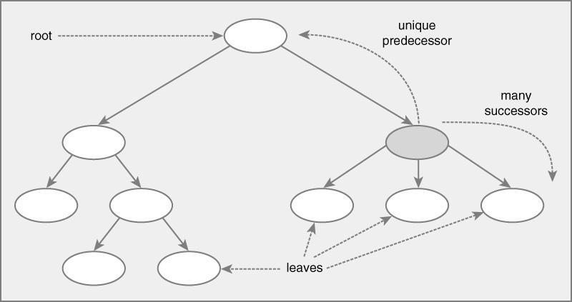
Trees
One-to-many relationship between elements
  Each element has unique predecessor
  Each element has multiple successors

Slide 25
Trees and Binary Trees
Tree: Single root
Binary tree : 0 - 2 children per node
  defined recursively:
    Either it is empty (the base case)
    or it consists of a root and two subtrees, each of which is a binary tree
Tree
Binary Tree

Slide 26
A Binary Tree
info
info
info
null
info
info
info
null
null
null
null
null
info
null
null

Slide 27
Tree ADT
Operations
  return first element (root)
  return successor elements (children)
  return predecessor element (parent)
  add element
  remove element
  contains an element
  …

Slide 28

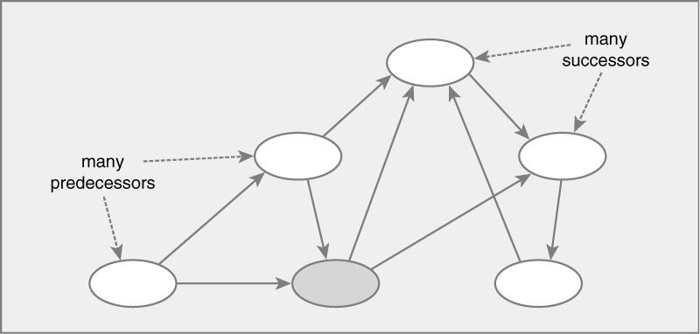
Graph Data Structures
Many-to-many relationship between elements
  Each element has multiple predecessors
  Each element has multiple successors

Slide 29
Different types of Graphs
Undirected graph -- Undirected edges
Directed graph (or digraph) -- Directed edges
  ex: airline flights between airports
Directed acyclic graph (DAG)
  Directed edges, no cycles
Undirected
Directed
DAG

Slide 30
Graph ADT
Operations
  return successor nodes
  return predecessor nodes
  return adjacent nodes (neighbors)
  add element
  remove element
  contains an element
  …

Slide 31
Outline
Intro to Collections
Dynamic Structures
Abstract Data Types
  Linear ADT
    Lists
    Sets
    Maps
  Hierarchical ADT
    Trees
    Graphs
Java Collections Framework
Iterator Interface

Slide 32
Java Collections Framework
The Java standard library contains several classes that represent collections: the Java Collections API
The Collections framework consists of
  Interfaces
    Abstract data type
  Implementations
    Reusable data structures
  Algorithms
    Reusable functionality
      e.g. sorting, searching, reverse order, …

Slide 33
Java Collections Framework
Goals
  Reduce programming effort
  Make APIs easier to learn, to design and implement
  Reuse software
  Increase performance
similar to the Standard Template Library (STL) in C++.
Collections can contain only Object reference types (no primitives).

Slide 34
Collections are ADTs
Collections are one of the best-designed parts of Java, because
  They are elegant
    they combine maximum power with maximum simplicity
    intelligent use of interfaces
  They are uniform
    when you know how to use one, you almost know how to use them all
  You can easily convert from one to another

Slide 35
Java Collections Framework
Iterators
  Iterator (interface)
Collections
  Collection (interface)
    Set (interface)
      HashSet
      TreeSet
    List (interface)
      ArrayList
      LinkedList
      Vector
  Map (interface)
    HashMap
    HashTable
    TreeMap

Slide 36
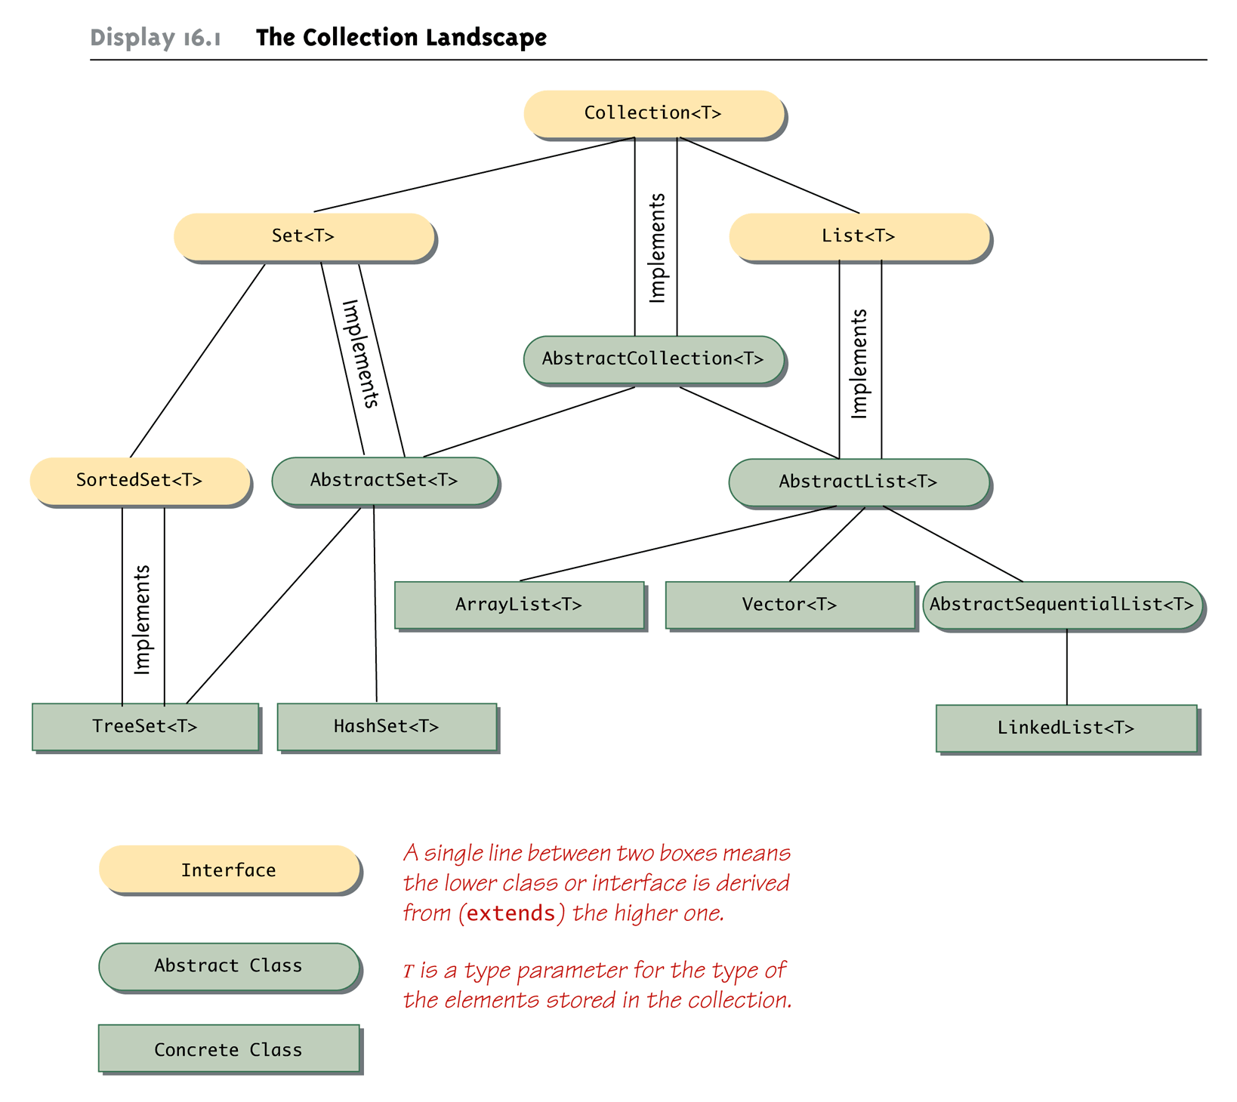

The Collection<E> Landscape

Slide 37
The Collection Framework
The Collection interface describes the basic operations that all collection classes should implement
Since an interface is a type, any method can be defined with a parameter of type Collection

Slide 38
Wildcards
Classes and interfaces in the collection framework can have parameter type specifications that do not fully specify the type plugged in for the type parameter
  Because they specify a wide range of argument types, they are known as wildcards
  public void method(String arg1, ArrayList<?> arg2)
  In the above example, the first argument is of type String, while the second argument can be an ArrayList<T> with any base type

Slide 39
Wildcards
A bound can be placed on a wildcard specifying that the type used must be an ancestor type or descendent type of some class or interface
  The notation <? extends String> specifies that the argument plugged in be an object of any descendent class of String
  The notation <? super String> specifies that the argument plugged in be an object of any ancestor class of String

Slide 40
Example
public static void fillIt(Collection<Integer> anyCollection) {
anyCollection.add(new Integer(4));
}
fillIt() can be called with any class that implements the collection interface
  ArrayList, TreeSet, LinkedList, … yourOwnClass
fillIt() can invoke add() with confidence that the behavior of add() will be appropriate for the specific type of object involved.
  thanks to what?

Slide 41
The Collection<E> interface
public interface Collection {
// Basic Operations
int size();
boolean isEmpty();
boolean contains(Object element);
boolean add(E element);
boolean remove(Object element);
Iterator iterator(); //returns an Iterator object which iterates over the elements
// Bulk Operations
boolean containsAll(Collection<?> c);
boolean addAll(Collection<? Extends E> c);
boolean removeAll(Collection<?> c);
…
// Array Operations
Object[] toArray(); // returns an array containing all elements in collection
<T> T[] toArray(T[] a);
}

Slide 42
Concrete classes
Collection, Set, SortedSet, List, and Map are interfaces
Each of these has specific implementations (classes)
  Set (order?, duplicates allowed?)
    HashSet
    TreeSet (rapid retrieval of elements in a sorted set)
  List (order?, duplicates allowed?)
    ArrayList
    LinkedList
  Map (key/value pairs, duplicates allowed?)
    HashMap
    HashTable
    TreeMap

Slide 43
Concrete classes
Interface | Concrete class | Description
Set<E> use if you need no duplicates | HashSet<E> | A hash table
SortedSet<E> use if you need no duplicates but you need an order | TreeSet<E> | Balanced Binary tree provides rapid retrieval of elements
List<E> use if you need duplicates or you need an order | ArrayList<E> | Resizable Array use if you need efficient random access to elements
 | Vector<E> | Resizable Array (Java 1.0/1.1) do not use anymore, use ArrayList instead
 | LinkedList<E> | Doubly-linked use if you need efficient sequential access
Map<K,V> | HashMap<K,V> | Hash table
use if you need key/value pairs, no duplicates | HashTable<K,V> | Hash table
SortedMap<K,V> use if you need a map with an order | TreeMap<K,V> | Balanced Binary tree

Slide 44
The Set<E> interface
the Set<E> interface inherits from Collection<E>
but changes the semantics of some of the methods.
E.g.:
  boolean add(E obj)
  Adds the specified element to this set if ___

Slide 45
Example: Sets.java
  final int LOOP_SIZE = 100000;
  final int DELETE_SIZE = 5000;
  TreeSet<Integer> tSet = new TreeSet<Integer>();
  for (int i = 0; i < LOOP_SIZE; i++){
  tSet.add(new Integer(i));
  }
  HashSet<Integer> hSet = new HashSet<Integer>();
  for (int i = 0; i < LOOP_SIZE; i++){
  hSet.add(new Integer(i));
  }
  for (int i = 0; i < LOOP_SIZE; i++){
  tSet.contains(new Integer(i));
  }
  for (int i = 0; i < LOOP_SIZE; i++){
  hSet.contains(new Integer(i));
  }
  for(int i = 0; i < DELETE_SIZE; i++){
  tSet.remove(new Integer(i));
  }
  for (int i = 0; i < DELETE_SIZE; i++){
  hSet.remove(new Integer(i));
  }

Slide 46
Example: Sets.java
// Binary trees are implicitly sorted.
System.out.println("\nFirst 10 elements of sorted TreeSet");
Iterator myIter = tSet.iterator();
for(int i = 0; i < 10; i++){
Integer myInt = (Integer)myIter.next();
System.out.println( myInt.intValue() );
}
// To sort the hashset, you first need to extract the values of the set into an array.
System.out.println("\nFirst 10 elements of unsorted HashSet");
Object[] hArray = hSet.toArray();
for(int i = 0; i < 10; i++){
Integer myInt = (Integer)hArray[i];
System.out.println( myInt.intValue() );
}
// You must then pass the array to Arrays.sort() in the java.util package.
System.out.println("\nFirst 10 elements of sorted HashSet");
Arrays.sort(hArray);
for(int i = 0; i < 10; i++){
Integer myInt = (Integer)hArray[i];
System.out.println( myInt.intValue() );
}

Slide 47
The List<E> interface
the List interface inherits from Collection
but changes the semantics of some methods,
and adds new methods. The list starts its index at 0.
void add(int i, E obj) // insert obj at position i in the list
boolean add(E obj) // add obj at the end of the list
E get(int i) // returns the element at position i
int indexOf(Object obj) // returns index of 1st element equal to
// obj, or -1
E remove(int i) // removes the element at position i and
// returns it
  …

Slide 48
Example: Lists.java
final int LOOP_SIZE = 100000;
final int SEARCH_SIZE = 1000;
ArrayList<Integer> aList = new ArrayList<Integer>();
for (int i = 0; i < LOOP_SIZE; i++){
aList.add(new Integer(i));
}
LinkedList<Integer> lList = new LinkedList<Integer>();
for (int i = 0; i < LOOP_SIZE; i++){
lList.add(new Integer(i));
}
// List search
for(int i = (LOOP_SIZE/2); i < ((LOOP_SIZE/2) + SEARCH_SIZE); i++)
aList.contains( new Integer(i));
for(int i = (LOOP_SIZE/2); i < ((LOOP_SIZE/2) + SEARCH_SIZE); i++)
lList.contains( new Integer(i));
// List Insertion
for(int i = (LOOP_SIZE/2); i < ((LOOP_SIZE/2) + SEARCH_SIZE); i++)
aList.add( i, new Integer(i));
for(int i = (LOOP_SIZE/2); i < ((LOOP_SIZE/2) + SEARCH_SIZE); i++)
lList.add( i, new Integer(i));
Collections.sort(aList);
Collections.sort(lList);

Slide 49
Example: IteratorTest.java
class IteratorTest {
public static void main( String [ ] args ) {
List<String> l1 = new ArrayList<String>();
l1.add("Carol"); l1.add("Amy"); l1.add("Bill"); l1.add("Bill");
List<String> l2 = new LinkedList<String>();
l2.add("Carol"); l2.add("Amy"); l2.add("Bill"); l2.add("Bill");
Set<String> s1 = new TreeSet<String>();
s1.add("Carol"); s1.add("Amy"); s1.add("Bill"); s1.add("Bill");
Set<String> s2 = new HashSet<String>();
s2.add("Carol"); s2.add("Amy"); s2.add("Bill"); s2.add("Bill");
Set<String> s3 = new TreeSet(Collections.reverseOrder());
s3.add("Carol"); s3.add("Amy"); s3.add("Bill"); s3.add("Bill");
System.out.println(l1);
System.out.println(l2);
System.out.println(s1);
System.out.println(s1);
System.out.println(s3);
}
output?

Slide 50
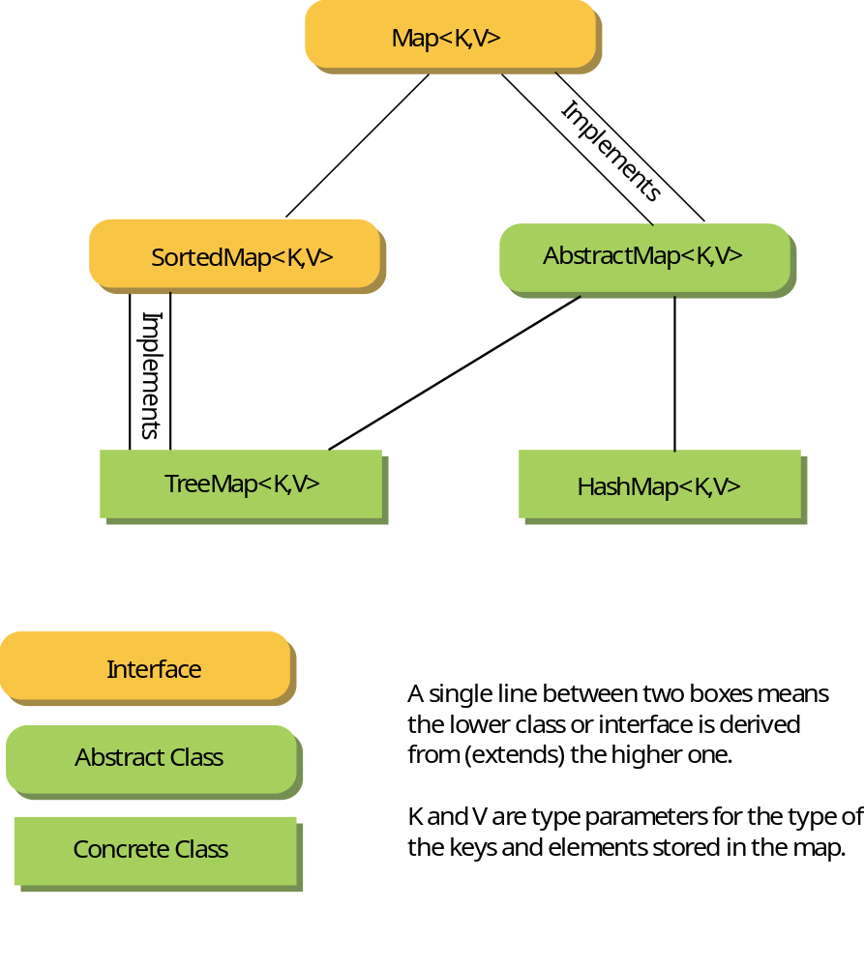
The Map<K,V> Landscape (p. 919)

Slide 51
The Map<K,V> interface
useful methods:
boolean containsKey(Object key) // true if map contains mapping
// for key
boolean containsValue(Object val) // true if map has a key
// mapping to val
V get(Object key) // returns the value mapped by key
Set<K> keySet() // returns all the keys as a Set
V put(K key, V val) // adds a mapping from key to val
V remove(Object key) // removes the mapping for key
  …

Slide 52
Concrete classes
Interface | Concrete class | Description
Set<E> use if you need no duplicates | HashSet<E> | A hash table
SortedSet<E> use if you need no duplicates but you need an order | TreeSet<E> | Balanced Binary tree provides rapid retrieval of elements
List<E> use if you need duplicates or you need an order | ArrayList<E> | Resizable Array use if you need efficient random access to elements
 | Vector<E> | Resizable Array (Java 1.0/1.1) do not use anymore, use ArrayList instead
 | LinkedList<E> | Doubly-linked use if you need efficient sequential access
Map<K,V> | HashMap<K,V> | Hash table
use if you need key/value pairs, no duplicates | HashTable<K,V> | Hash table
SortedMap<K,V> use if you need a map with an order | TreeMap<K,V> | Balanced Binary tree

Slide 53
Example: Maps.java
Integer myInt;
final int LOOP_SIZE = 100000;
HashMap<String,Integer> hMap = new HashMap<String,Integer>();
for(int i = 0; i < LOOP_SIZE; i++){
myInt = new Integer(i);
hMap.put( myInt.toString(), myInt);
}
TreeMap<String,Integer> tMap = new TreeMap<String,Integer>();
for(int i = 0; i < LOOP_SIZE; i++){
myInt = new Integer(i);
tMap.put( myInt.toString(), myInt);
}
for(int i = 0; i < LOOP_SIZE; i++) // Set search
hMap.get("Moose Jaw");
for(int i = 0; i < LOOP_SIZE; i++) { // Set insertion
myInt = new Integer(i);
hMap.put( myInt.toString(), myInt);
}

Slide 54
Outline
Intro to Collections
Dynamic Structures
Abstract Data Types
  Linear ADT
    Lists
    Sets
    Maps
  Hierarchical ADT
    Trees
    Graphs
Java Collections Framework
Iterator Interface

Slide 55
The Iterator<E> Interface
how do we visit each element in a collection one at a time?
code for different structures will be different
Iterator
  Common interface for all Collection classes
  Used to examine all elements in collection
Properties
  Order of elements is unspecified (may change)
  Can remove current element during iteration
  Works for any collection

Slide 56
The Collection<E> interface
public interface Collection {
// Basic Operations
int size();
boolean isEmpty();
boolean contains(Object element);
boolean add(E element);
boolean remove(Object element);
Iterator<E> iterator(); //returns an Iterator object which iterates over the elements
// Bulk Operations
boolean containsAll(Collection<?> c);
boolean addAll(Collection<? Extends E> c);
boolean removeAll(Collection<?> c);
…
// Array Operations
Object[] toArray(); // returns an array containing all elements in collection
<T> T[] toArray(T[] a);
}

Slide 57
The Iterator Interface
An Iterator does not stand on its own
  It must be associated with some collection object using the method iterator
  If c is an instance of a collection class:
  Iterator<T> iteratorForC = c.iterator();

Slide 58
Iterators
Iterators provide a way of visiting the elements of a collection one by one
can be seen as a cursor between elements of the collection
next()
*
*
*
*
*
hasNext()
true
hasNext()
false
iterator

Slide 59


Iterator<E> Interface
Interface:
Example:
public interface Iterator {
  boolean hasNext(); // Returns true if the iterator can be
  // moved forward
  E next(); // Moves the iterator forward one position
  // and returns the element it has passed over
  void remove(); // Removes the element that has just been
  // passed over by next()
}
myCollection = new List<Airplane>();
  Iterator<Airplane> i = myCollection.iterator();
  while (i.hasNext()) {
  Airplane ap = i.next();
  // do what ever you want with ap
  }

Slide 60
Example
Iterator<Telephone> iter;
c1 = new LinkedList<Telephone>();
iter = c1.iterator();
while (iter.hasNext()) {
Object obj = iter.next();
//do what you want to obj
}
c2 = new HashSet<Telephone>();
iter = c2.iterator();
while (iter.hasNext()) {
Object obj = iter.next();
//do what you want to obj
}
identical code
for generating the
sequence of objects

Slide 61

Iterator example
Collection<String> sixtiesGroups = new LinkedList<String>();
sixtiesGroups.add("Vandellas");
sixtiesGroups.add("Chiffons");
sixtiesGroups.add("Crystals");
Iterator<String> iter = sixtiesGroups.iterator();
while (iter.hasNext()) {
String grp = iter.next();
if (grp.equals("Chiffons"))
iter.remove();
System.out.println(grp);
}
what if we want to use ArrayList instead?
A HashSet?

Slide 62
Back to Arrays
Arrays are not part of the Collections Framework, but they haven’t been ignored
Java 1.2 introduced the Arrays class, with some useful operations, for example:
  static void sort(Object[] a)
  static int binarySearch(Object[] a, Object key)
  static boolean equals(Object[] a, Object[] a2)
  static void fill(Object[] a, Object val)
  static void fill(Object[] a, Object val,
  int from, int to)
  static List asList(Object[] a)

Slide 63
Generic methods
method to print all elements of any type of collection
NB you don’t need this since the Collection interface has a toString method
public static <T> void print ( ) {
}

